Slide 1
Exceptional Exceptions
with @LlewellynFalco & @JamesRCounts

Slide 2
Eddie Izzard’s printer
http://youtu.be/k6C_HjWr3Nk?t=3m30s

Slide 3
Rules
All code must compile
All exceptions must be thrown because of standard calls to the .Net BCL
All improvements must be possible

Slide 4
Today’s Goal
The next time you write
throw new Exception(…);
…you will remember this talk

Slide 5
Playing the Game
Show code that caused the exception to be thrown
Ask why?
Propose better Exception Message
Ask again

Slide 6
The route to null evil

Slide 7
11
12
13
14
var a = Router.GetRoute("A");
var b = Router.GetRoute("B");
var c = Router.GetRoute("C");
var result = new Helper(a.From, b.To, c.ViaProxy).Send();
System.NullReferenceException: Object reference not set to an instance of an object.
at ExceptionalExamples.UnitTests.NullRef() in UnitTest1.cs: line 14
What is null?
A) a
B) b
C) c
D) I don’t know

Slide 8
IL_0028: ldloc.1 IL_0029: callvirt instance object ExceptionalExamples.Route::get_To()
Object reference not set to an instance of an object.
throw new NullReferenceException(“Object reference not set to an instance of an object.”)
Null reference while executing: Route.To
throw new NullReferenceException(
"Null reference while executing: {0}.{1}",
m.ClassName,
m.MethodSignature());

Slide 9
11
12
13
14
var a = Router.GetRoute("A");
var b = Router.GetRoute("B");
var c = Router.GetRoute("C");
var result = new Helper(a.From, b.To, c.ViaProxy).Send();
System.NullReferenceException:
Null reference while executing: Route.To
at ExceptionalExamples.UnitTests.NullRef() in UnitTest1.cs: line 14
What is null?
A) a
B) b
C) c
D) I don’t know

Slide 10
This exception proves the rule…
“Print variable values
in your error messages”
…to give the confused coder some guidance

Slide 11
A heapful of rectangles

Slide 12
58
59
60
61
62
63
64
65
66
67
for (var i = 0; i < 10000; i++)
{
int w = random.Next(this.Width);
int h = random.Next(this.Height);
var start = new Point(0, 0);
var end = new Point(w, h);
var b = new LinearGradientBrush(start, end, Color.Red, Color.Blue);
var rect = new Rectangle(random.Next(Width), random.Next(Height), w, h);
e.Graphics.FillRectangle(b, rect);
}
What went wrong?
A) 10,000 rectangles
B) Brush too big
C) Garbage Collection
D) Other
System.OutOfMemoryException: Out of memory.
at LinearGradientBrush..ctor(Point p1, Point p2, Color c1, Color c2)
at MyForm.OnPaint(PaintEventArgs e) in c:\...\UnitTest1.cs:line 64
at Control.PaintWithErrorHandling(PaintEventArgs e, Int16 layer)
at Control.OnPrint(PaintEventArgs e)

Slide 13
A) new LinearGradientBrush(new Point(0, 0), new Point(w, h), Color.Red, Color.Blue);
B) new LinearGradientBrush(new Rectangle(0, 0, w, h), Color.Red, Color.Blue, 1.0f);
Out of memory
throw new OutOfMemoryException(“Out of memory.”)
Rectangle '{X=0,Y=0,Width=189,Height=0}' cannot have a width or height equal to 0.
throw new ArgumentException(
@"Rectangle ‘{{X={0},Y={1},Width={2},Height={3}}}'
cannot have a width or height equal to 0.",
start.X, start.Y, end.X - start.X, end.Y - start.Y);

Slide 14
58
59
60
61
62
63
64
65
66
67
for (var i = 0; i < 10000; i++)
{
int w = random.Next(this.Width);
int h = random.Next(this.Height);
var start = new Point(0, 0);
var end = new Point(w, h);
var b = new LinearGradientBrush(start, end, Color.Red, Color.Blue);
var rect = new Rectangle(random.Next(Width), random.Next(Height), w, h);
e.Graphics.FillRectangle(b, rect);
}
What went wrong?
A) 10,000 rectangles
B) Brush too big
C) Garbage Collection
D) Other
Rectangle '{X=0,Y=0,Width=189,Height=0}' cannot have a width or height equal to 0.
at LinearGradientBrush..ctor(Point p1, Point p2, Color c1, Color c2)
at MyForm.OnPaint(PaintEventArgs e) in c:\...\UnitTest1.cs:line 64
at Control.PaintWithErrorHandling(PaintEventArgs e, Int16 layer)
at Control.OnPrint(PaintEventArgs e)
Height is 0

Slide 15
This exception proves the rule…
“If the framework gives you bad exceptions, throw better ones”
…to give the confused coder some guidance

Slide 16
This exception proves the rule…
“Print other variables to provide context”
Rectangle '{X=0,Y=0,Width=189,Height=0}'
…to give the confused coder some guidance

Slide 17
Cast into the (Void)

Slide 18
11
12
13
Component[] from = { new Button(), new Form(), new ToolTip(), };
Component[] to = new Collage().GetMemories();
Array.Copy(from, to, from.Length);
System.InvalidCastException: At least one element in the source array could not be cast down to the destination array type.
at System.Array.Copy(Array s, Array d, Int32 l)
at UnitTests.ArrayCopy() in UnitTest1.cs: line 13
What doesn’t fit?
A) Button
B) Form
C) ToolTip
D) I don’t know

Slide 19
13
Array.Copy(from, to, from.Length);
At least one element in the source array could not be cast down to the destination array type.
throw new InvalidCastException (“…text…”)
<Form> could not be cast to destination array type <Control[]>
throw new InvalidCastException(
"<{0}> could not be cast to destination array type <{1}>",
element.GetType().Name, to.GetType().Name);

Slide 20
11
12
13
Component[] from = { new Button(), new Form(), new ToolTip(), };
Component[] to = new Collage().GetMemories();
Array.Copy(from, to, from.Length);
System.InvalidCastException: <Form> could not be cast to destination array type <Control[]>
at System.Array.Copy(Array s, Array d, Int32 l)
at UnitTests.ArrayCopy() in UnitTest1.cs: line 13
What doesn’t fit?
A) Button
B) Form
C) ToolTip
D) I don’t know

Slide 21
This exception proves the rule…
“Runtime details make it clear where the error comes from”
…to give the confused coder some guidance

Slide 22
A date with a parser

Slide 23
75
var dateTime = DateTime.Parse(form.Date);
System.FormatException: The string was not recognized as a valid DateTime. There is an unknown word starting at index 7.
at System.DateTimeParse.Parse(String s, DateTimeFormatInfo dtfi, DateTimeStyles styles)
at System.DateTime.Parse(String s)
at ExceptionalExamples.UnitTests.DateTimeParse() in UnitTest1.cs: line 75
How do you need to sanitize the date?
A) Include CultureInfo
B) Remove “th”
C) Only use first three letters of the month
D) Other

Slide 24
75
var dateTime = DateTime.Parse(form.Date);
The string was not recognized as a valid DateTime. There is an unknown word starting at index 7
throw new FormatException (“…text…” + index)
Cannot parse "March 6th 2010“ at index 7
Valid formats include:
"<Month> <Day> <Year>" => “January 14 2010”
"<Month>/<Day>/<Year>" => “1/14/2010”
"<Year>-<Month>-<Day>" => “2010-01-24”
throw new FormatException(@"Cannot parse '{0}' at index {1}
Valid formats include: {2}",
input, 7, tldr);

Slide 25
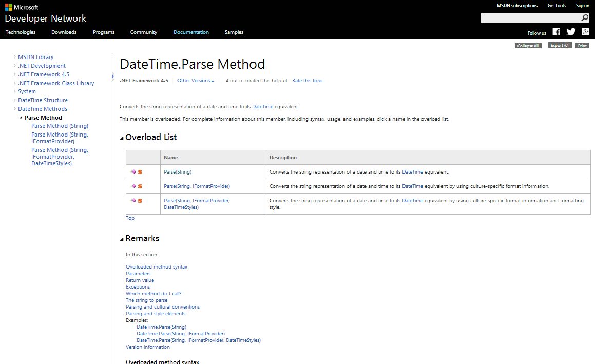

Slide 26
75
var dateTime = DateTime.Parse(form.Date);
System.FormatException: Cannot parse "March 6th 2010" at index 7
Valid formats include:
"<Month> <Day> <Year>" => "January 14 2010"
"<Month>/<Day>/<Year>" => "1/14/2010"
"<Year>-<Month>-<Day>" => "2010-01-24"
at System.DateTimeParse.Parse(String s, DateTimeFormatInfo dtfi, DateTimeStyles styles)
at System.DateTime.Parse(String s)
at ExceptionalExamples.UnitTests.DateTimeParse() in UnitTest1.cs: line 75
How do you need to sanitize the date?
A) Include CultureInfo
B) Remove “th”
C) Only us first three letters of the month
D) Other

Slide 27
This exception proves the rule…
“Show tl;dr examples if
particular formats are required”
…to give the confused coder some guidance

Slide 28
Touching your privates in public

Slide 29
82
83
84
85
86
var su = new SignUpPrompt();
su.Advertise();
var pb = new PrivateObject(su.BuyButton, new PrivateType(typeof(ButtonBase)));
var isAnimating = (bool)pb.Invoke("GetFlag", new[] { 0x0010 });
Assert.IsTrue(isAnimating);
private bool GetFlag(int flag)
What went wrong?
A) Not on ButtonBase
B) Wrong parameters
C) Docs are out of date
D) Other
System.MissingMethodException:
Method 'System.Windows.Forms.ButtonBase.GetFlag' not found.
at System.RuntimeType.InvokeMember(String name, BindingFlags bindingFlags, …)
at ExceptionalExamples.UnitTests.ButtonAnimation() in UnitTest1.cs: line 85

Slide 30
85
var isAnimating = (bool)pb.Invoke("GetFlag", new[] { 0x0010 });
Method 'System.Windows.Forms.ButtonBase.GetFlag' not found.
throw new MissingMethodException (“…text…” + method + “…text…”)
Cannot find method: GetFlag(int[]).
Possible methods starting with “G” are:
GetFlag(int)
GetPreferedSizeCore(Size)
Common Fixes
If method not listed it might be on a base class
i.e. new PrivateObject(o, new PrivateType(typeof(BaseClass)))
If method is listed check your parameter list
i.e. p.Invoke(“MethodName”, param1, param2)

Slide 31
throw new MissingMethodException(@"Cannot find method: {0}.
Possible methods starting with “{1}” are:\n{2}
Common Fixes\n{3}“,
method, method[0], this.GetMethodsStartingWith(method[0]),
commonFixes);

Slide 32
82
83
84
85
86
var su = new SignUpPrompt();
su.Advertise();
var pb = new PrivateObject(su.BuyButton, new PrivateType(typeof(ButtonBase)));
var isAnimating = (bool)pb.Invoke("GetFlag", new[] { 0x0010 });
Assert.IsTrue(isAnimating);
System.MissingMethodException:
Cannot find method: GetFlag(int[]).
Possible methods starting with “G” are:
GetFlag(int)
GetPreferedSizeCore(Size)
Common Fixes
If method not listed it might be on a base class
i.e. new PrivateObject(o, new PrivateType(typeof(BaseClass)))
If method is listed check your parameter list
i.e. p.Invoke(“MethodName”, param1, param2)
at System.RuntimeType.InvokeMember(String name, BindingFlags bindingFlags, …)
at ExceptionalExamples.UnitTests.ButtonAnimation() in UnitTest1.cs: line 85
What went wrong?
A) Not on ButtonBase
B) Wrong parameters
C) Docs are out of date
D) Other

Slide 33
This exception proves the rule…
“Don’t hold back,
You don’t know which clue will help”
…to give the confused coder some guidance

Slide 34
82
83
84
85
86
var su = new SignUpPrompt();
su.Advertise();
var pb = new PrivateObject(su.BuyButton);
var isAnimating = (bool)pb.Invoke("GetFlag", 0x0010);
Assert.IsTrue(isAnimating);
System.MissingMethodException:
Cannot find method: GetFlag(int).
Possible methods starting with “G” are:
<none>
Common Fixes
If method not listed it might be on a base class
i.e. new PrivateObject(o, new PrivateType(typeof(BaseClass)))
If method is listed check your parameter list
i.e. p.Invoke(“MethodName”, param1, param2)
at System.RuntimeType.InvokeMember(String name, BindingFlags bindingFlags, …)
at ExceptionalExamples.UnitTests.ButtonAnimation() in UnitTest1.cs: line 85
What went wrong?
A) Not on Button
B) Wrong parameters
C) Docs are out of date
D) Other

Slide 35
Don’t disturb the natives
…or Dynamically Lost Library

Slide 36
82
...
100
101
NativeDll.svn_client_info();
[DllImport("libsvn_client-1-0.dll")]
public static extern int svn_client_info();
06/25/2014 09:59 PM 10,240 ExceptionalExamples.dll
06/03/2014 06:11 AM 255,849 libsvn_client-1-0.dll
2 File(s) 266,089 bytes
Why can’t we find the DLL?
A) Wrong File Permissions
B) Wrong Working Directory
C) Wrong Processor Arch
D) Other
System.DllNotFoundException:
Unable to load DLL 'libsvn_client-1-0.dll':
The specified module could not be found.
(Exception from HRESULT: 0x8007007E)
at ExceptionalExamples.NativeDll.svn_client_info()
at ExceptionalExamples.UnitTests.NativeTest() in UnitTest1.cs: line 82

Slide 37
100
[DllImport("libsvn_client-1-0.dll")]
Unable to load DLL 'libsvn_client-1-0.dll':
The specified module could not be found.
(Exception from HRESULT: 0x8007007E)
throw new DllNotFoundException (“…text…” + index)
Problems loading dependencies for “libsvn_client-1-0.dll”.
Could not find dependency: “MSYS-1.0.dll”
Required libraries:
MSYS-1.0.dll
LIBSVN_DELTA-1-0.DLL
LIBSVN_DIFF-1-0.DLL
LIBAPR-0-0.DLL
LIBSVN_SUBR-1-0.DLL

Slide 38
throw new DllNotFoundException(@"Problems loading dependencies for '{0}'.
Could not find dependency: '{1}'
Required libraries:\n{2}",
dll,
missingDependancy,
allDependancies.ToReadableString());

Slide 39
82
...
100
101
NativeDll.svn_client_info();
[DllImport("libsvn_client-1-0.dll")]
public static extern int svn_client_info();
06/25/2014 09:59 PM 10,240 ExceptionalExamples.dll
06/03/2014 06:11 AM 255,849 libsvn_client-1-0.dll
2 File(s) 266,089 bytes
System.DllNotFoundException:
Problems loading dependencies for “libsvn_client-1-0.dll”.
Could not find dependency: “MSYS-1.0.dll”
Required libraries:
MSYS-1.0.dll
LIBSVN_DELTA-1-0.DLL
LIBSVN_DIFF-1-0.DLL
LIBAPR-0-0.DLL
LIBSVN_SUBR-1-0.DLL
at ExceptionalExamples.NativeDll.svn_client_info()
at ExceptionalExamples.UnitTests.NativeTest() in UnitTest1.cs: line 82
Why can’t we find the DLL?
A) Wrong File Permissions
B) Wrong Working Directory
C) Wrong Processor Arch
D) Other

Slide 40
This exception proves the rule…
“Highlight root causes”
…to give the confused coder some guidance

Slide 41
Today’s Goal
The next time you write
throw new Exception(…);
…you will remember this talk

Slide 42
Use variable values
Wrap bad exceptions
Provide context
Show runtime details
tl;dr examples
Extra information
Highlight root causes

Slide 43
Cue Cards
Your options are | How can you make this exceptional? | Show me the code | Lets ask our studio audience
Unfortunately, when I run this… | Prove to me that you can do this in code | Lets go back in time | What am I supposed to learn from this?
Applause

Slide 44
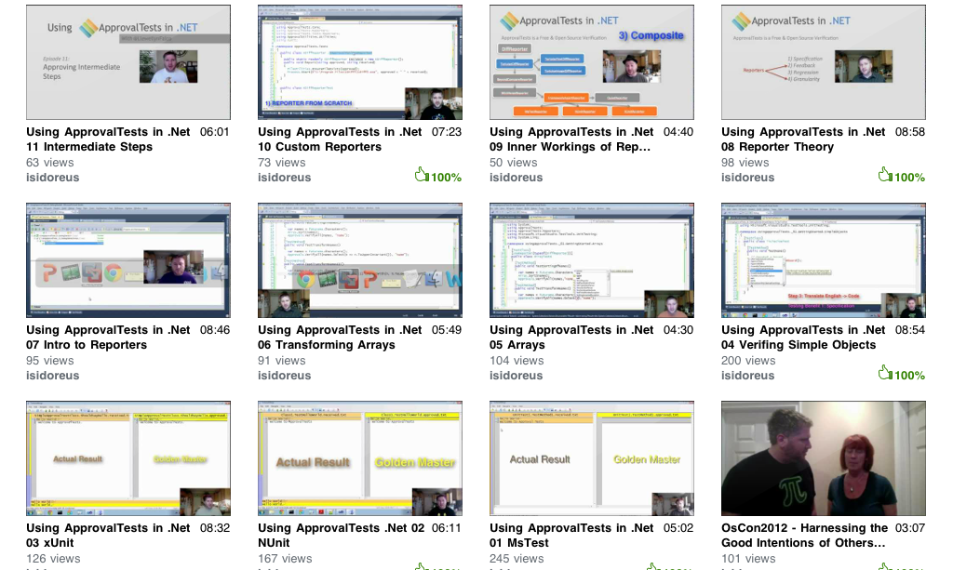
Approval Tests
20 episode youtube series

Slide 45


Slide 46
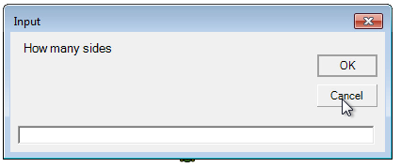


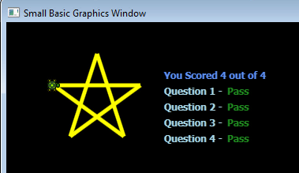
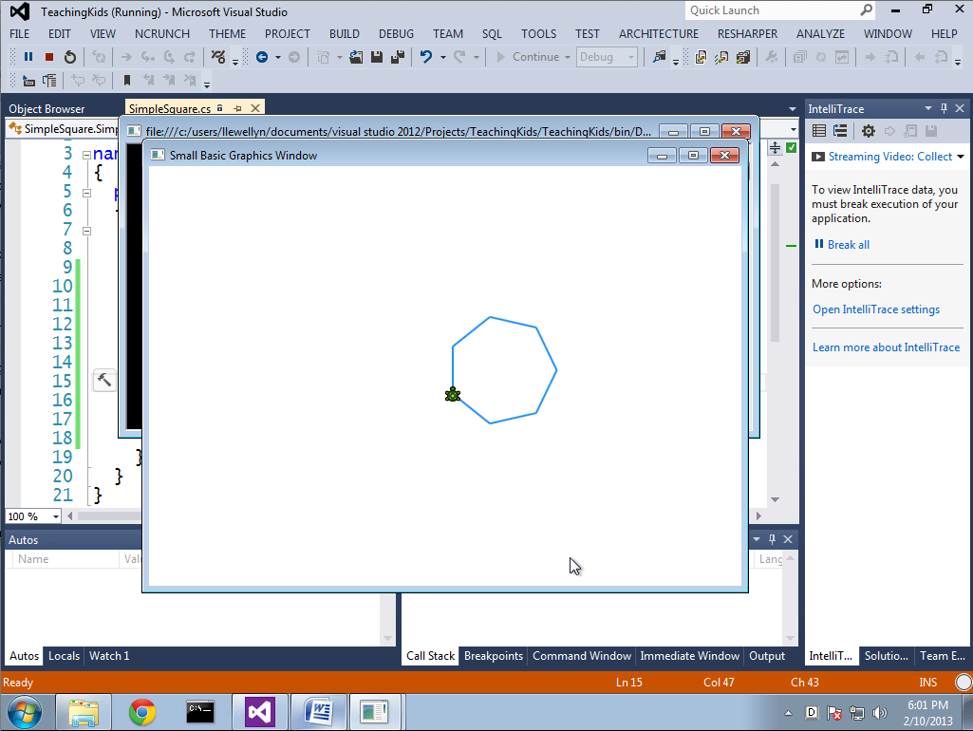

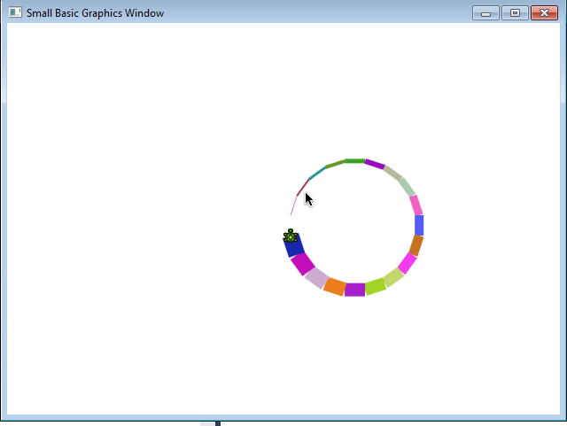
pluralsight.com/kids

Slide 47


Contact Information
Slides at http://lfal.co/ExceptionalExceptions
@JamesRCounts
http://IHadThisIdeaOnce.com
@LlewellynFalco http://LlewellynFalco.Blogspot.com

Slide 48
This exception proves the rule…
“Give example code
for any setup needed”
…to give the confused coder some guidance

Slide 49
This exception proves the rule…
“Point to online documentation”
…to give the confused coder some guidance

